Slide 1
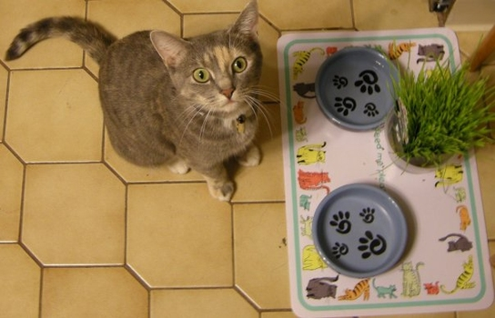
Commonwealth Charter Schools Question 2 Potential Impact on Arlington Public Schools
Paul Schlichtman Arlington School Committee
September 24, 2016

Slide 2
The current charter school
cap is really a plug in the fiscal drain. For most Massachusetts districts, the drain is plugged at 9% of Net School Spending. For the bottom 10% of districts the drain is plugged at 18% of Net School Spending.
If the per pupil charter school garnishment from local districts is cut in half, the number of available charter school seats would double.

Slide 3
In FY 2017, Massachusetts
DEFLATED the per-pupil foundation budget by -0.22% In FY 2017, Net District Cost for Charter Schools (district garnishment after all reimbursements) increased from $412,811,820 to $451,338,729, a 9.33% increase. This is happening to school districts under the current charter school cap. A yes vote on Question 2, and 12 new charter schools every year, will make things much worse for children in our public schools.

Slide 4
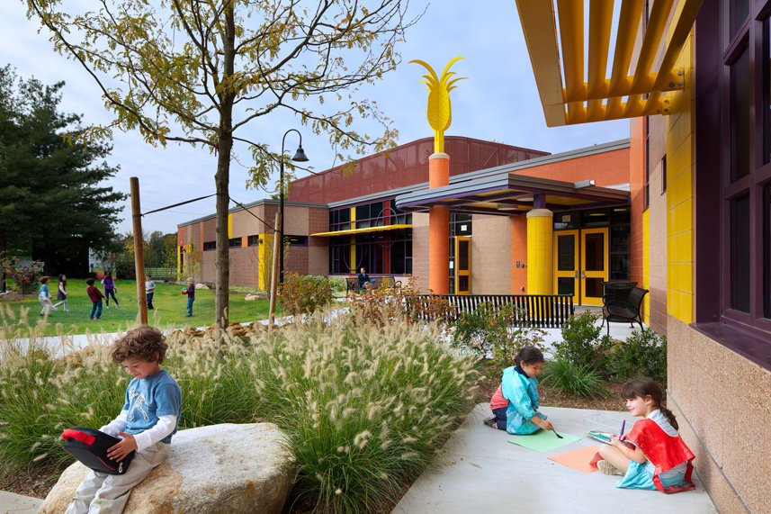
How do we fund public school districts in Massachusetts?

Slide 5
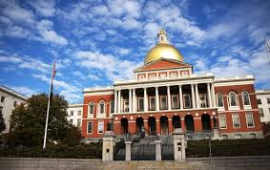
Education Reform Act of 1993 Foundation Budget. Based on the cost of providing an adequate education in 1993.

Slide 6
Arlington Foundation Budget: FY16 $50,290,292

Slide 7
Required District Contribution: What the town can afford.
Arlington Foundation Budget: FY16 $50,290,292

Slide 8
Chapter 70 State Aid: Fills the gap between Required District Contribution & Foundation Budget.
Arlington Foundation Budget: FY16 $50,290,292

Slide 9
Cities and towns may choose to spend above required levels.
Arlington Net School Spending: FY16 $66,329,048
131.9% of foundation

Slide 10
Most cities and towns spend in excess of state requirements.

Slide 11
Arlington public school funding under Education Reform: FY93-FY16

Slide 12
FY16: Arlington spends at 131.9% of foundation.

Slide 13
FY16: Arlington spends at 526.8% of foundation on out-of-district SPED.

Slide 14
FY16: Arlington spends at 240.0% of foundation on in-district SPED.

Slide 15
FY16: Arlington spends at 106.4% of foundation on all non-SPED line items.

Slide 16
• Entitlement, not subject to appropriation • Garnished from sending town’s Chapter 70 appropriation • Based on average per-pupil spending. (FY 17 projected charter per-pupil, $13,777)
Charter school funding:

Slide 17
Entitlement, not subject to appropriation: Not “subject to appropriation” by the legislature. No vote permitted by Town Meeting or City Council of sending towns.
Charter school funding:

Slide 18
Law provides for reimbursement to districts for increases in charter tuition. Year 1: 100% Years 2-6: 25% Year 7 and beyond: 0% Charter industry claims districts are reimbursed at 225% of cost. “Subject to appropriation” by the legislature. The (FY17) budget allocates $85,500,000 in charter aid. This appropriation will cover 50% of the actual requirement.”* *Final FY16 reimbursement was at 63% of the actual requirement.
Charter school funding:

Slide 19
How charter garnishments compare to in-district per-pupil spending

Slide 20
Current charter school cap is 9% of Net School Spending $5,969,614
Arlington Net School Spending: FY16 $66,329,048

Slide 21
Current charter school cap is 9% of Net School Spending $5,969,614 = 482 students
Arlington Net School Spending: FY16 $66,329,048

Slide 22
Lift the cap? 865 charter students $5,969,614 garnishment Exhausts Chapter 70 funding, Unrestricted General Government Aid next target.
Arlington Net School Spending: FY16 $66,329,048

Slide 23
Natick & Arlington: Similar Size Districts
Natick Public Schools:
5 Elementary (K-4)
2 Middle Schools (5-8)
1 High School

Slide 24
Natick & Arlington: Similar Size Districts
Natick Public Schools:
5 Elementary (K-4)
2 Middle Schools (5-8)
1 High School
39 Natick Students in Charter Schools:
$435,421 Ch. 70 Garnishment $0 State Reimbursement $11,165 per pupil cost DESE Preliminary Charter Tuition, FY17

Slide 25
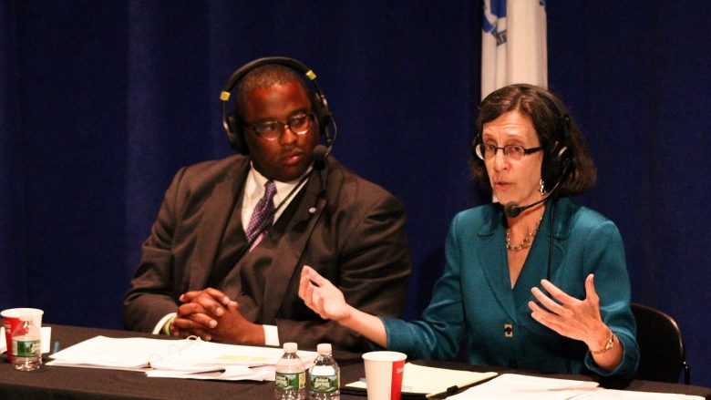
“The state has sent approximately one billion dollars back to school districts to help ease the transition when students go to charter schools, to help them readjust. What we’re seeing is that some districts are not making the adjustments that they need to make due to their enrollment.” Martha M. “Marty” Walz Former State Representative and Senior Advisor to Democrats for Education Reform WBUR charter school debate, September 13, 2016
39 Natick Students in Charter Schools:
$435,421 Ch. 70 Garnishment $0 State Reimbursement $11,165 per pupil cost DESE Preliminary Charter Tuition, FY17

Slide 26
“The state has sent approximately one billion dollars back to school districts to help ease the transition when students go to charter schools, to help them readjust. What we’re seeing is that some districts are not making the adjustments that they need to make due to their enrollment.” Martha M. “Marty” Walz Former State Representative and Senior Advisor to Democrats for Education Reform WBUR charter school debate, September 13, 2016
39 Natick Students in Charter Schools:
$435,421 Ch. 70 Garnishment $0 State Reimbursement $11,165 per pupil cost DESE Preliminary Charter Tuition, FY17
How do you adjust for a
$435,421 loss of revenue, when 39 students leave a system of 8 schools, with 13 grade levels?

Slide 27
“And charter schools were created in 1993 specifically to give families a choice because they needed to get out of their failing district schools. And so the idea here is to get away from locally controlled schools, in some instances for charters, because local control has led to far too many children not being well educated by district schools. ” Martha M. “Marty” Walz Former State Representative and Senior Advisor to Democrats for Education Reform WBUR charter school debate, September 13, 2016
Boston Globe, Sep. 14, 1993: Under the education reform law cosponsored by Roosevelt and signed by Weld on June 18, the state committed itself to a $1.3 billion increase in state spending on schools by the year 2000, mostly in low-income cities with poor-performing school systems, in order to ensure that every school in the state could spend at least $5,550 per student annually by then.

Slide 28
“And charter schools were created in 1993 specifically to give families a choice because they needed to get out of their failing district schools. And so the idea here is to get away from locally controlled schools, in some instances for charters, because local control has led to far too many children not being well educated by district schools. ” Martha M. “Marty” Walz Former State Representative and Senior Advisor to Democrats for Education Reform WBUR charter school debate, September 13, 2016
Boston Globe, Sep. 14, 1993: The law also requires students to meet strict new standards to graduate from high school, mandates a battery of new student assessment tests to evaluate how well individual schools are doing, replaces teacher tenure with a simpler way of getting rid of poor teachers, provides more money for teachers' continuing education, and transfers the power to hire and fire teachers from school boards to principals.

Slide 29
“And charter schools were created in 1993 specifically to give families a choice because they needed to get out of their failing district schools. And so the idea here is to get away from locally controlled schools, in some instances for charters, because local control has led to far too many children not being well educated by district schools. ” Martha M. “Marty” Walz Former State Representative and Senior Advisor to Democrats for Education Reform WBUR charter school debate, September 13, 2016
Boston Globe, June 7, 1993: "Charter schools," innovative schools given public money but run by groups of teachers, parents, universities or museums, have been limited to 25, with no more than five in Boston, and they may not open before September 1995 and may not enroll more than about 6,500 students.

Slide 30
Question 2: This proposed law would allow the state Board of Elementary and Secondary Education to approve up to 12 new charter schools or enrollment expansions in existing charter schools each year. Approvals under this law could expand statewide charter school enrollment by up to 1% of the total statewide public school enrollment (9,534) each year. New charters and enrollment expansions approved under this law would be exempt from existing limits on the number of charter schools, the number of students enrolled in them, and the amount of local school districts' spending allocated to them.
If the Board received more than 12 applications in a single year from qualified applicants, then the proposed law would require it to give priority to proposed charter schools or enrollment expansions in districts where student performance on statewide assessments is in the bottom 25% of all districts in the previous two years and where demonstrated parent demand for additional public school options is greatest.
New charter schools and enrollment expansions approved under this proposed law would be subject to the same approval standards as other charter schools, and to recruitment, retention, and multilingual outreach requirements that currently apply to some charter schools. Schools authorized under this law would be subject to annual performance reviews according to standards established by the Board.
The proposed law would take effect on January 1, 2017. (Source: MA Secretary of the Commonwealth)
Notes:
Statewide average charter tuition $12,675.75 (FY17), * 9,534 = $120,850,600

Slide 31
Question 2: This proposed law would allow the state Board of Elementary and Secondary Education to approve up to 12 new charter schools or enrollment expansions in existing charter schools each year. Approvals under this law could expand statewide charter school enrollment by up to 1% of the total statewide public school enrollment (9,534) each year.
1% of current statewide enrollment: 9,534 students Statewide average charter tuition (FY17): $12,675.75 Potential annual impact of 12 new charters (FY17): $120,850,600
Notes:
Statewide average charter tuition $12,675.75 (FY17), * 9,534 = $120,850,600

Slide 32
Charter school tuition increases at a much greater rate than Chapter 70 aid

Slide 35
Comparing Arlington’s Average Property Tax Bill
to Charter Tuition, FY16
Thus, according to common usage in the late Eighteenth Century, a duty to cherish was an obligation to support or nurture. Hence, the "duty . . . to cherish the interests of literature and the sciences, and all seminaries of them; especially . . . public schools and grammar schools in the towns" is an obligation to support or nurture these interests and institutions.
JAMI MCDUFFY & others vs. SECRETARY OF THE EXECUTIVE OFFICE OF EDUCATION & others (and a companion case). 415 Mass. 545

Slide 36
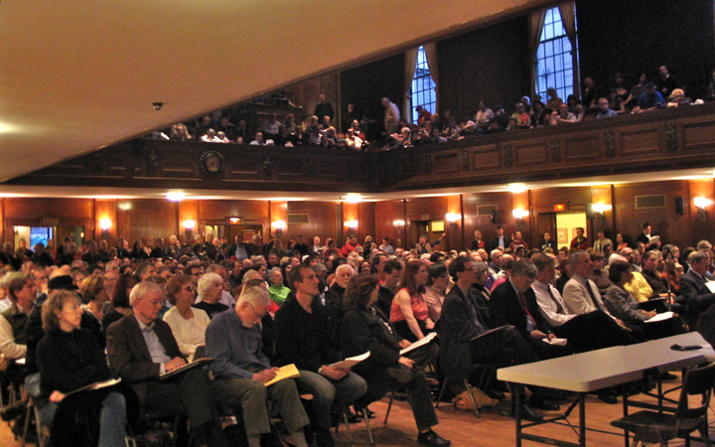
Arlington Town Meeting - 2015
ARTICLE 29 APPROPRIATION/COMMITTEES AND COMMISSIONS
VOTED: (UNANIMOUS)
That the sum of $25,695 be and hereby is appropriated to be expended by the following commissions, committees, and boards in the amounts indicated:
A. Arlington Historical Commission – $2,160
B. Historic District Commissions – $5,100
(Avon Place Historic District Commission, Broadway Historic District
Commission, Central Street Historic District commission, Jason/Gray
Historic District Commission, Russell Historic District Commission,
Pleasant Street Historic District Commission and Mount
Gilboa/Crescent Hill Historic District Commission)
C. Capital Planning Committee – $0
D. Commission on Disability – $3,000
E. Recycling Committee – $3,000
F. Human Rights Commission – $4,500
G. Arlington Tourism and Economic Development Committee - $1,775
H. Vision 2020 - $3,000
I. Transportation Advisory Committee - $0
J. Arlington Commission on Arts and Culture - $3,160
Said sums to be raised by general tax and expended under the direction of the various commissions, committees and boards.
A true copy of the vote under Article 29 of the Warrant for the Annual Town Meeting of the Town of Arlington at the session held May 11, 2015.
ATTEST: Town Clerk

Slide 37
Massachusetts: Strong tradition of setting a high standard for accountable local governance.

Slide 38
Massachusetts: Strong tradition of setting a high standard for accountable local governance. Commonwealth charter schools don’t meet our standards.

